Slide 1
logistic regression
Notes:
Welcome to the lecture on ””

Slide 2
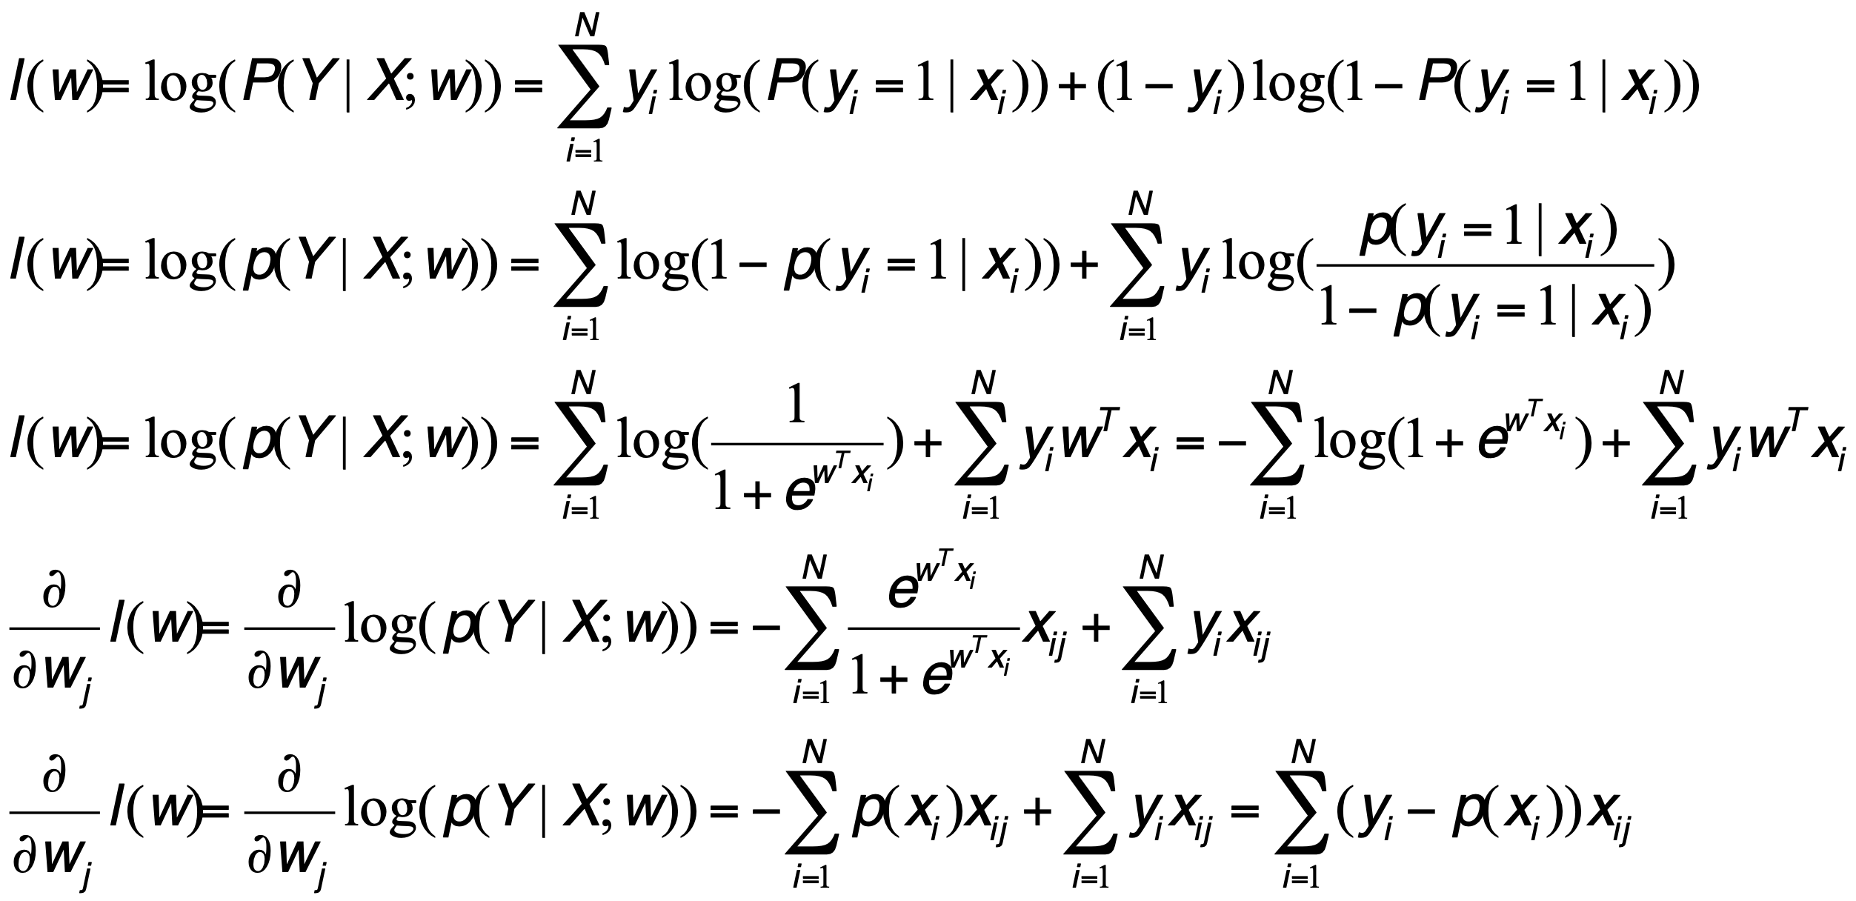
MLE (LR)
$$ln(\frac{P(y=1|x;w)}{P(y=0|x;w)})=w^{T}x$$
$$P(y=0|x;w)=\frac{e^{-w^{T}x}}{1+e^{-w^{T}x}}$$
$$P(y=0|x;w)=\frac{1}{1+e^{w^{T}x}}$$

Slide 3
Multiclass

Slide 4

Softmax and loss function
$$P(y=1|x;w)=\frac{e^{w^{T}x}}{1+e^{w^{T}x}}$$
Sigmoid to Softmax
Loss function
$$p,1-p$$
$$p_{1},p_{2};p_{1}+p_{2}=1$$
$$p_{1},p_{2},p_{3};p_{1}+p_{2}+p_{3}=1$$
$$l(w)=ln(P(Y|X;w))=Σ_{i=1}^{N}y_{i}ln(P(Y_{i}=1|x_{i})+(1-y_{i})ln(P(Y_{i}=0|x_{i}))$$
$$l(w)=ln(P(Y|X;w))=Σ_{i=1}^{N}y_{i}ln(p(x_{i}))+(1-y_{i})ln(1-p(x_{i}))$$

Slide 5
REFERENCES
Linear Regression - Multivariate
https://www.youtube.com/watch?v=qLCVj_Ej5VQ
Logistic Regression - Multivariate
https://www.youtube.com/watch?v=KIhPtHOfbhQ
Softmax Regression
https://www.youtube.com/watch?v=ACEOKYS5MUk
Book:
https://dafriedman97.github.io/mlbook/content/table_of_contents.html
KL divergence and Cross entropy:
https://www.youtube.com/watch?v=Pwgpl9mKars

Slide 6
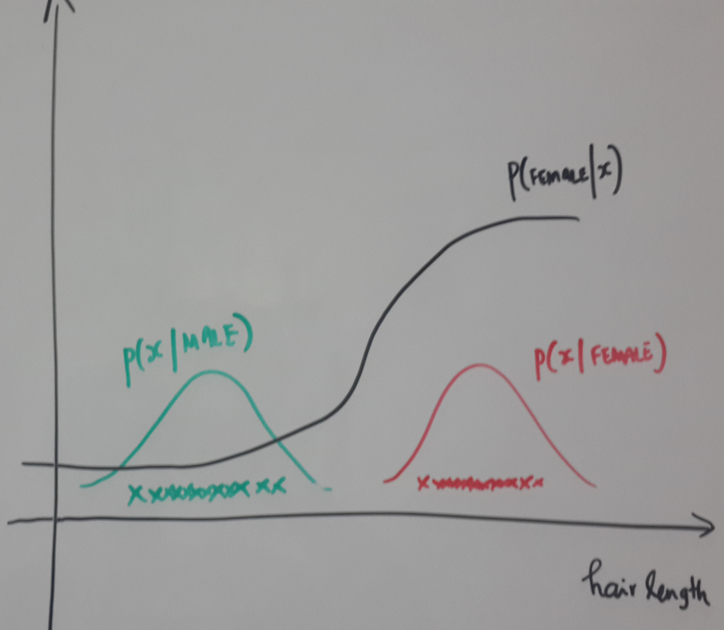
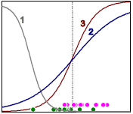
Probabilistic models: Generative vs Discriminative
Generative models
$$P(C=C_{k}|x)=\frac{p(x|C=C_{k})P(C=C_{k})}{p(x)}$$
Discriminative models
$$P(C=C_{k}|x)$$

Slide 7
Regression: Multivariate LInear Regression

Slide 8
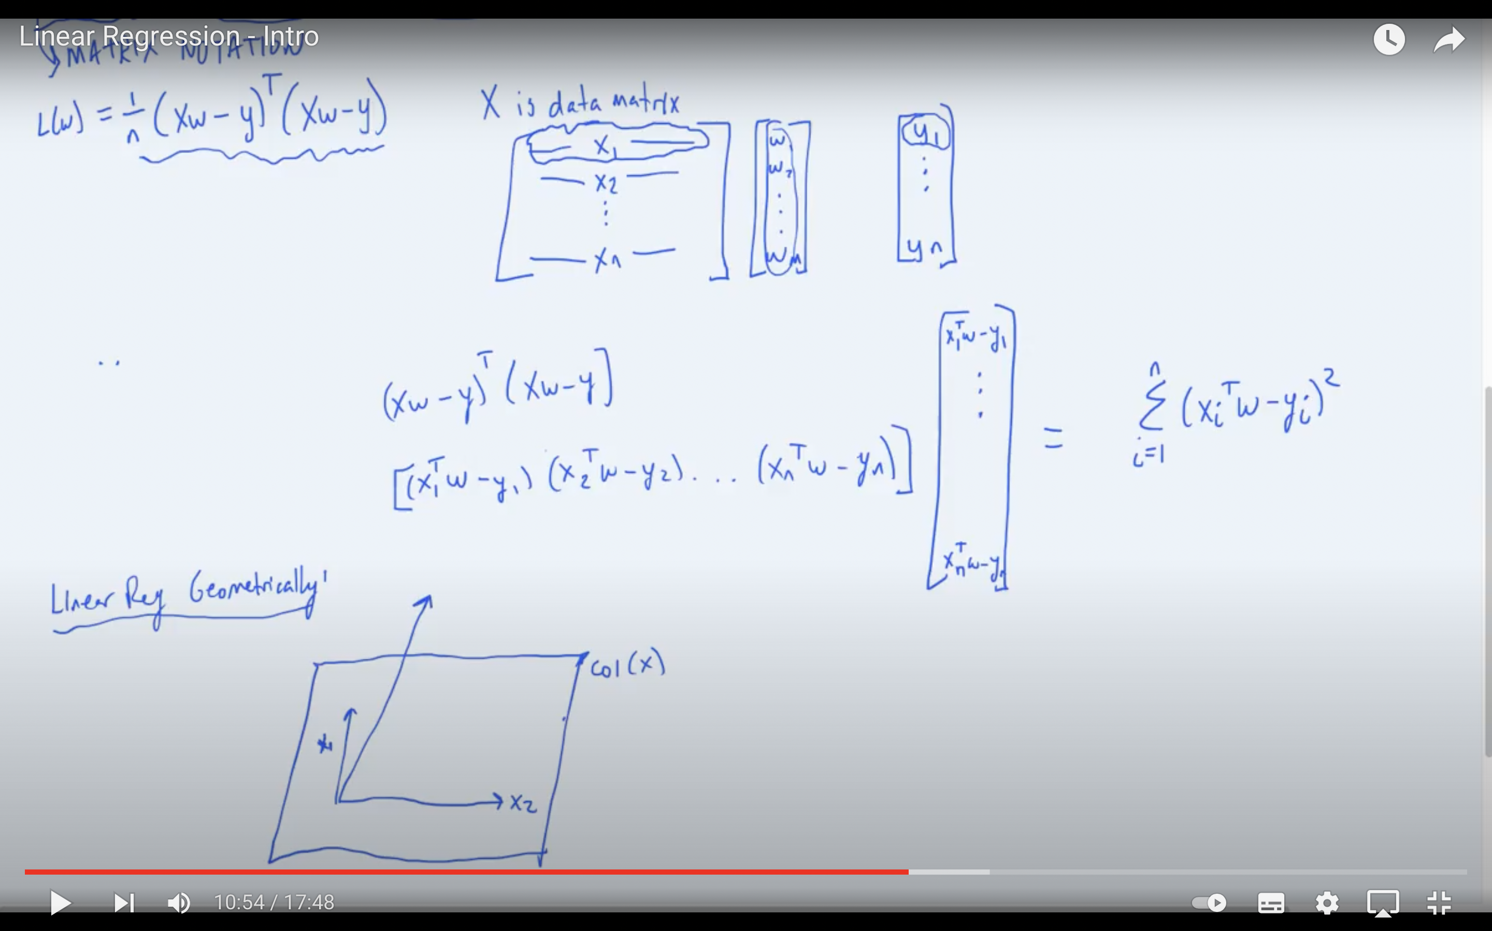
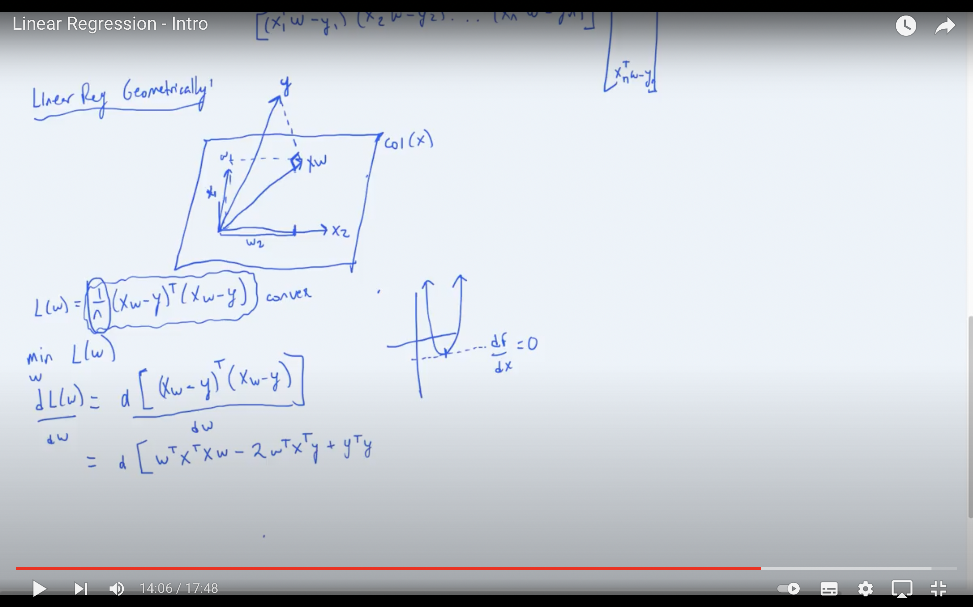

Slide 9
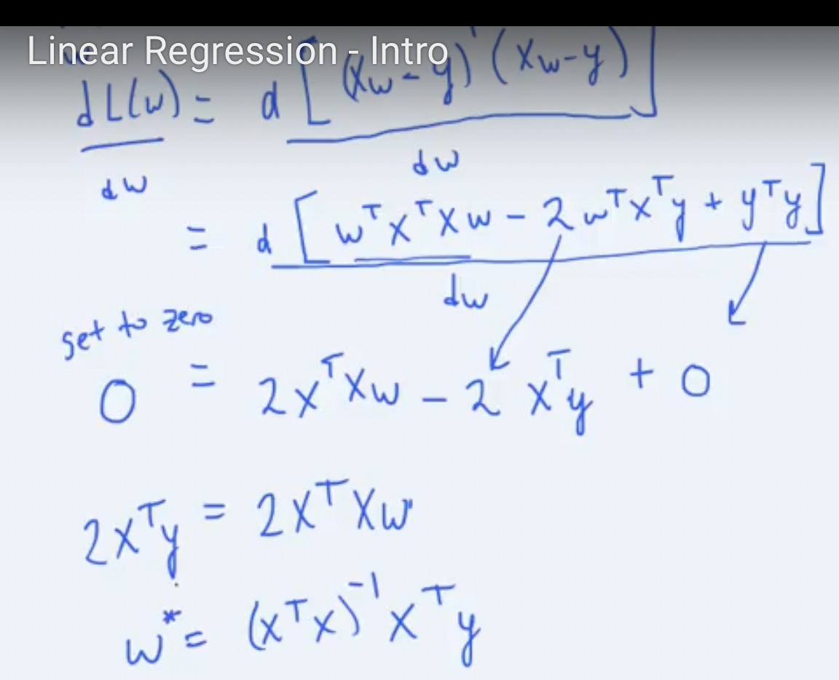
Pseudo inverse

Slide 10
CLASSIFICATION: LOGISTIC REGRESSION

Slide 14
CLASSIFICATION: SOFTMAX REGRESSION

Slide 15
Softmax and loss function
$$P(y=1|x;w)=\frac{e^{w^{T}x}}{1+e^{w^{T}x}}$$
Sigmoid to Softmax
Loss function
$$P(y=k|x;\{w\})=\frac{e^{w_{k}^{T}x}}{Σ_{j=1}^{K}e^{w_{j}^{T}x}}$$
$$p,1-p$$
$$p_{1},p_{2};p_{1}+p_{2}=1$$
$$p_{1},p_{2},p_{3};p_{1}+p_{2}+p_{3}=1$$
$$l(w)=ln(P(Y|X;w))=Σ_{n=1}^{N}y_{n}ln(P(Y_{n}=1|x_{n})+(1-y_{n})ln(P(Y_{n}=0|x_{n}))$$
$$l(w)=ln(P(Y|X;w))=Σ_{n=1}^{N}y_{n}ln(p(x_{n}))+(1-y_{n})ln(1-p(x_{n}))$$
$$l(w)=ln(P(Y|X;w))=Σ_{n=1}^{N}y_{n}ln(p_{1}(x_{n}))+(1-y_{n})ln(p_{2}(x_{n})))$$
$$l(w)=ln(P(Y|X;w))=Σ_{n=1}^{N}Σ_{k=1}^{K}y_{nk}ln(p_{k}(x_{n}))$$

Slide 16
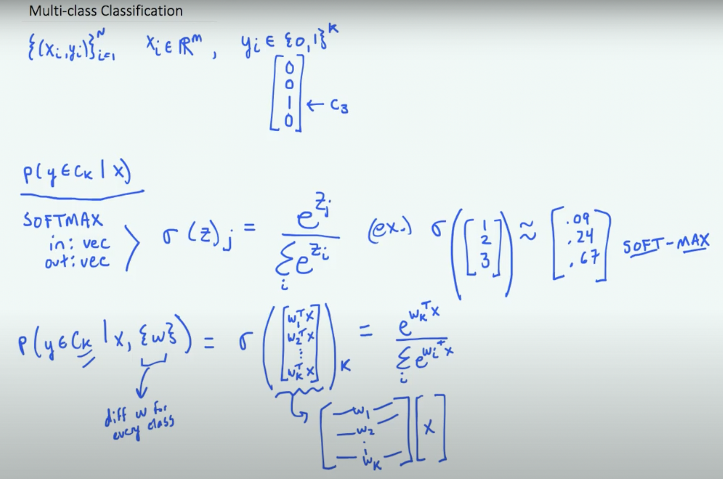

Slide 17
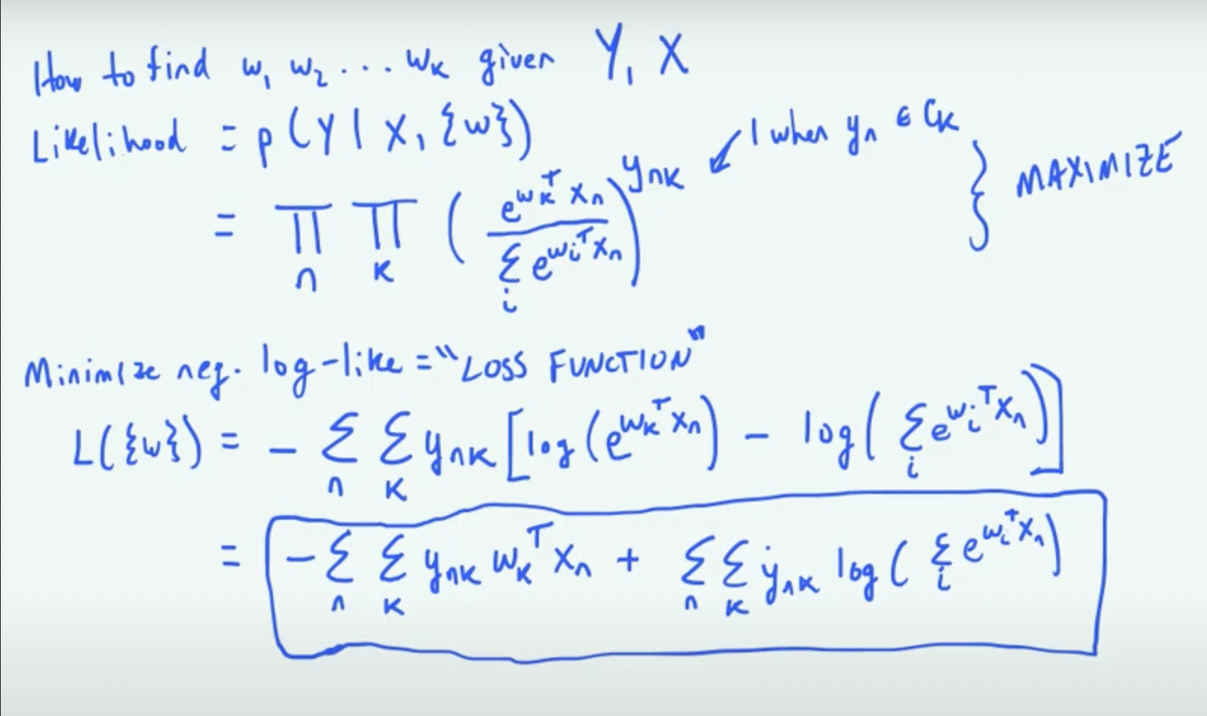

Slide 18
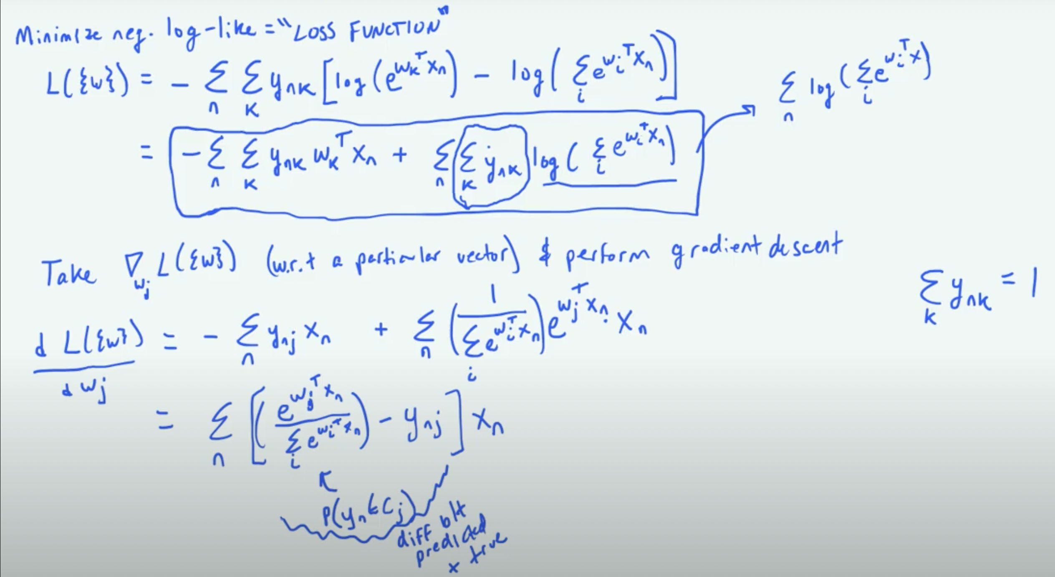

Slide 19
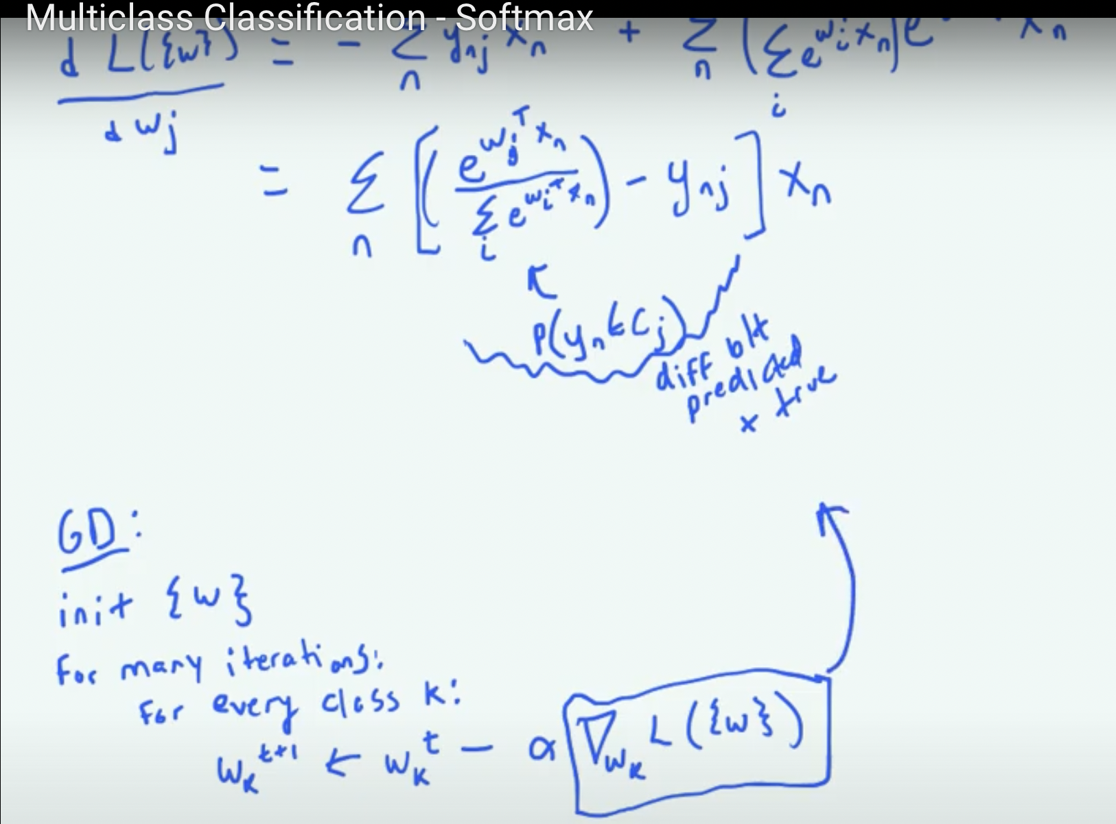

Slide 20
Naïve Bayes classifier
Probabilistic classifiers estimate
Use Bayes theorem
Use Naïve assumption, given class label the features are independent (class conditional independence)
$$P(C=C_{k}|x)$$
$$P(C=C_{k}|x)=\frac{p(x_{1}x_{2}|C=C_{k})P(C=C_{k})}{p(x)}$$
$$P(C=C_{k}|x)=\frac{p(x_{1}|C=C_{k})p(x_{2}|C=C_{k})P(C=C_{k})}{p(x)}$$

Slide 21
Bayes classifier
Probabilistic classifiers estimate
Given the 2D features, we want to estimate the probability that the class label C is say
C₁(i.e. MALE) or C₂(i.e. FEMALE)
Use Bayes theorem, assuming 2D feature vector
$$P(C=C_{k}|x)$$
$$P(C=C_{k}|x)=\frac{p(x_{1}x_{2}|C=C_{k})P(C=C_{k})}{p(x)}$$

Slide 22
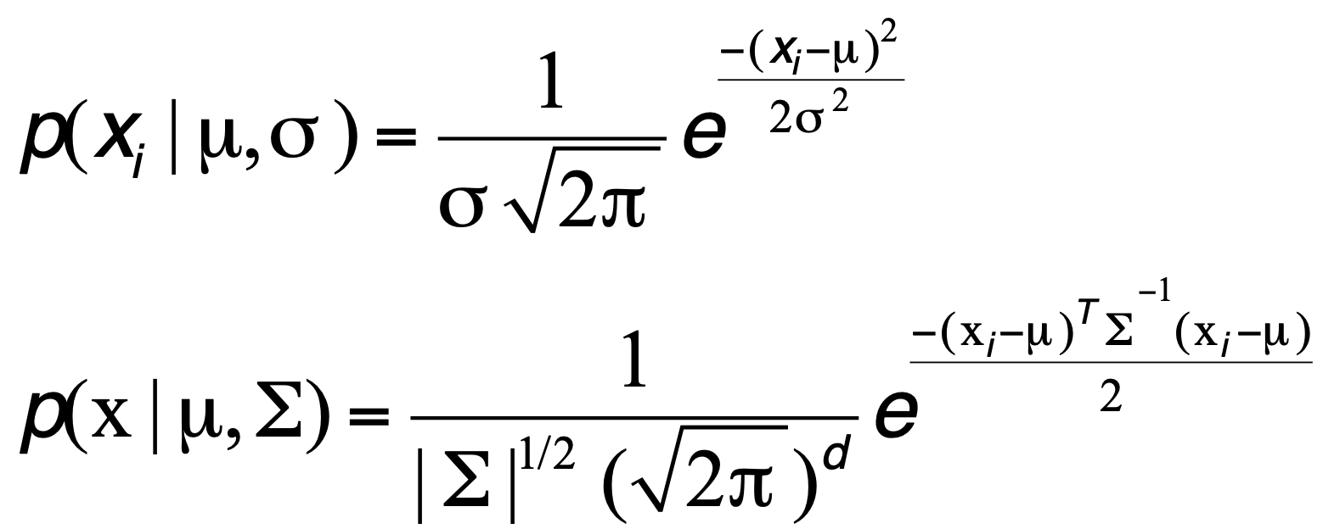
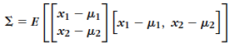
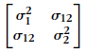
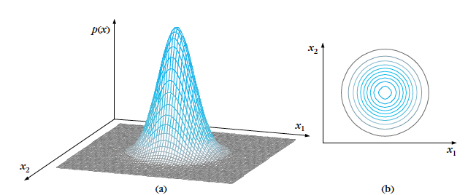
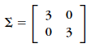
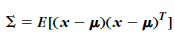
Multivariate Gaussian
i

Slide 23
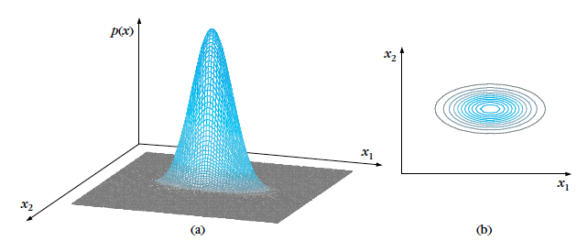
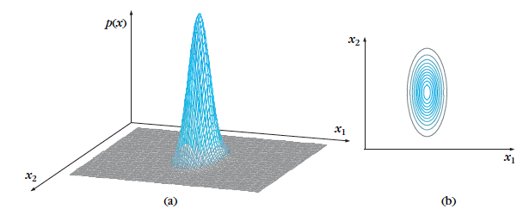

Slide 24
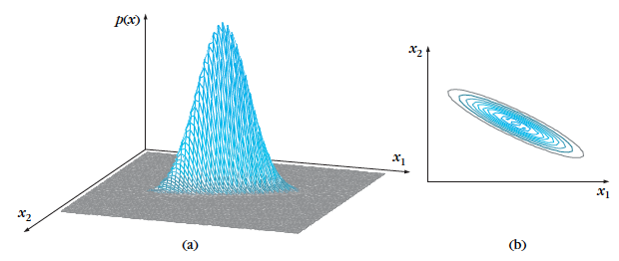
Reading: B3. Pages 20-24

Slide 25
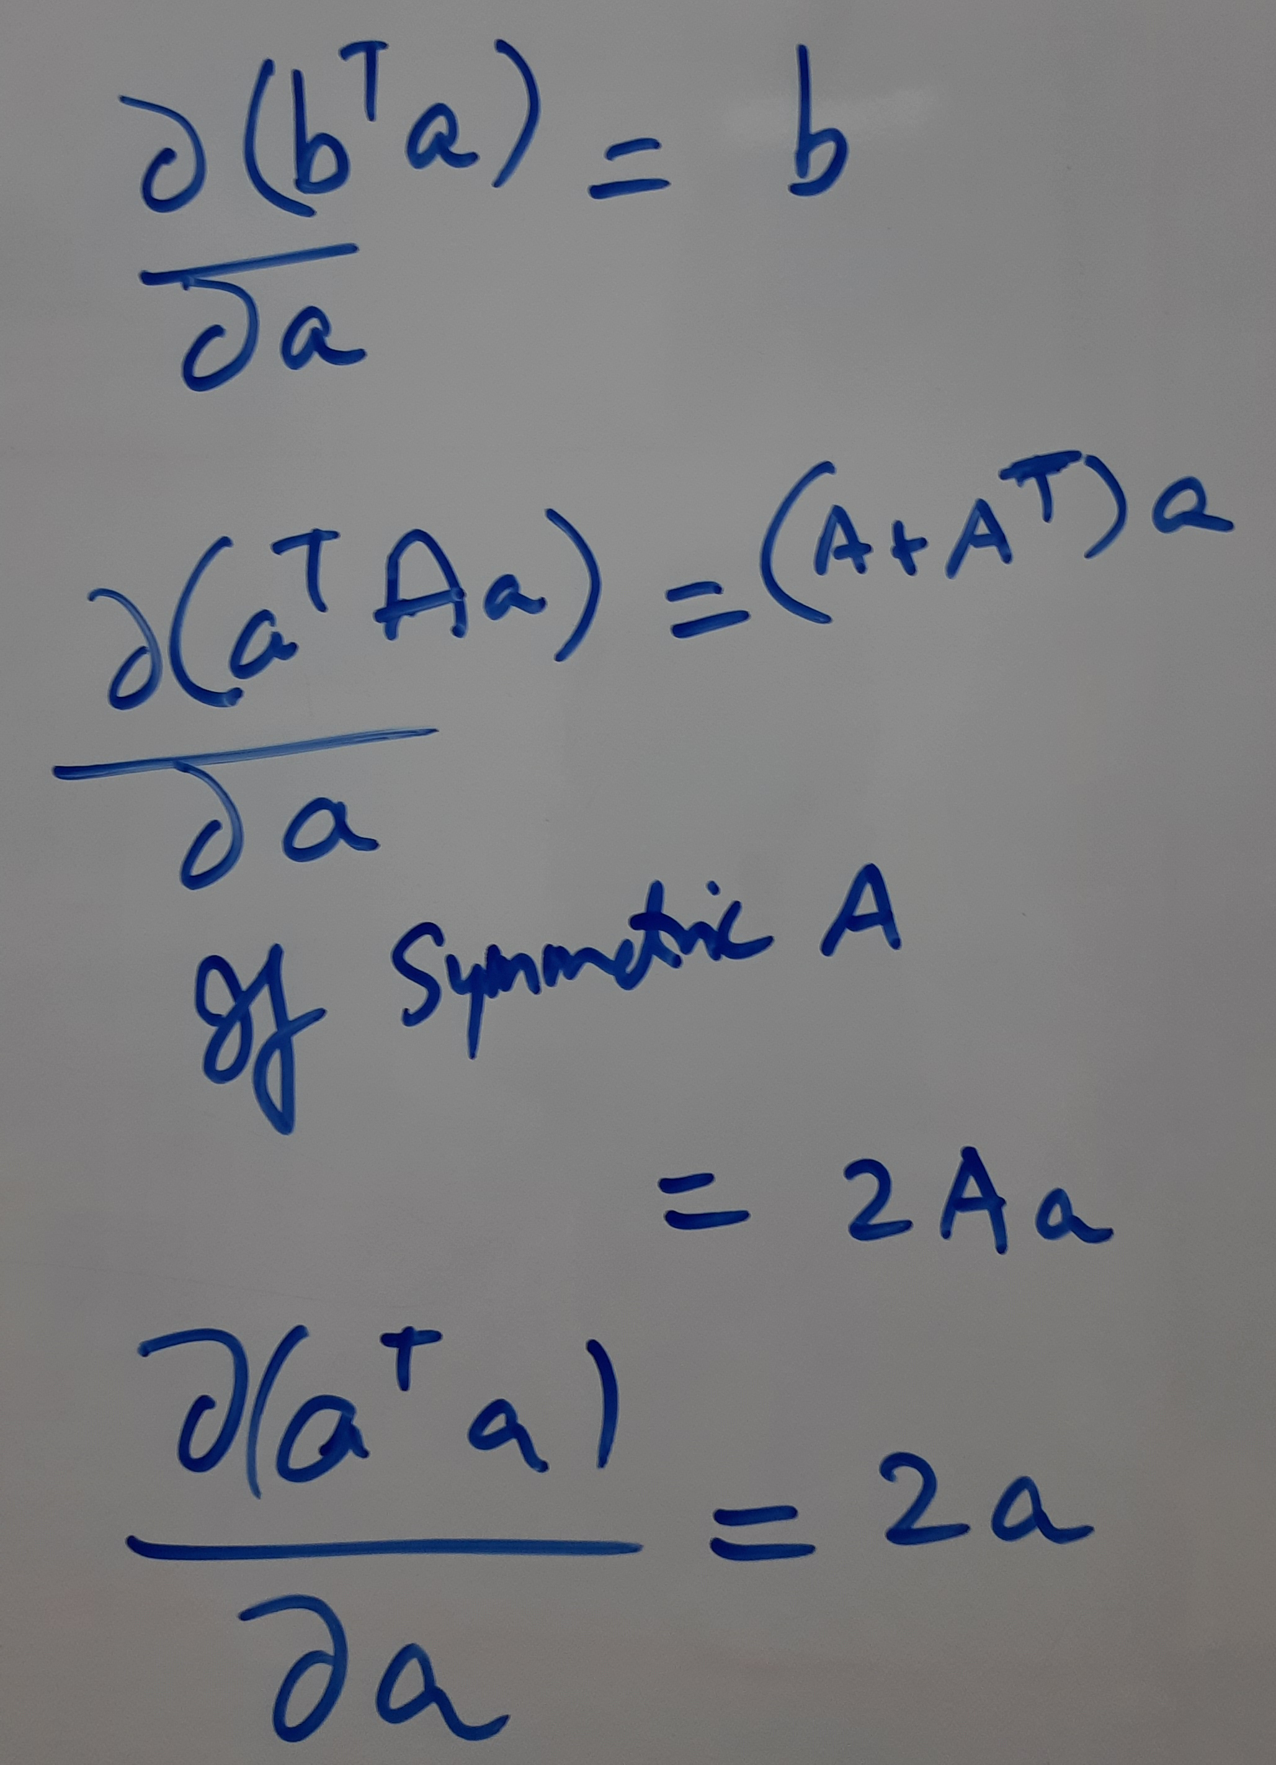
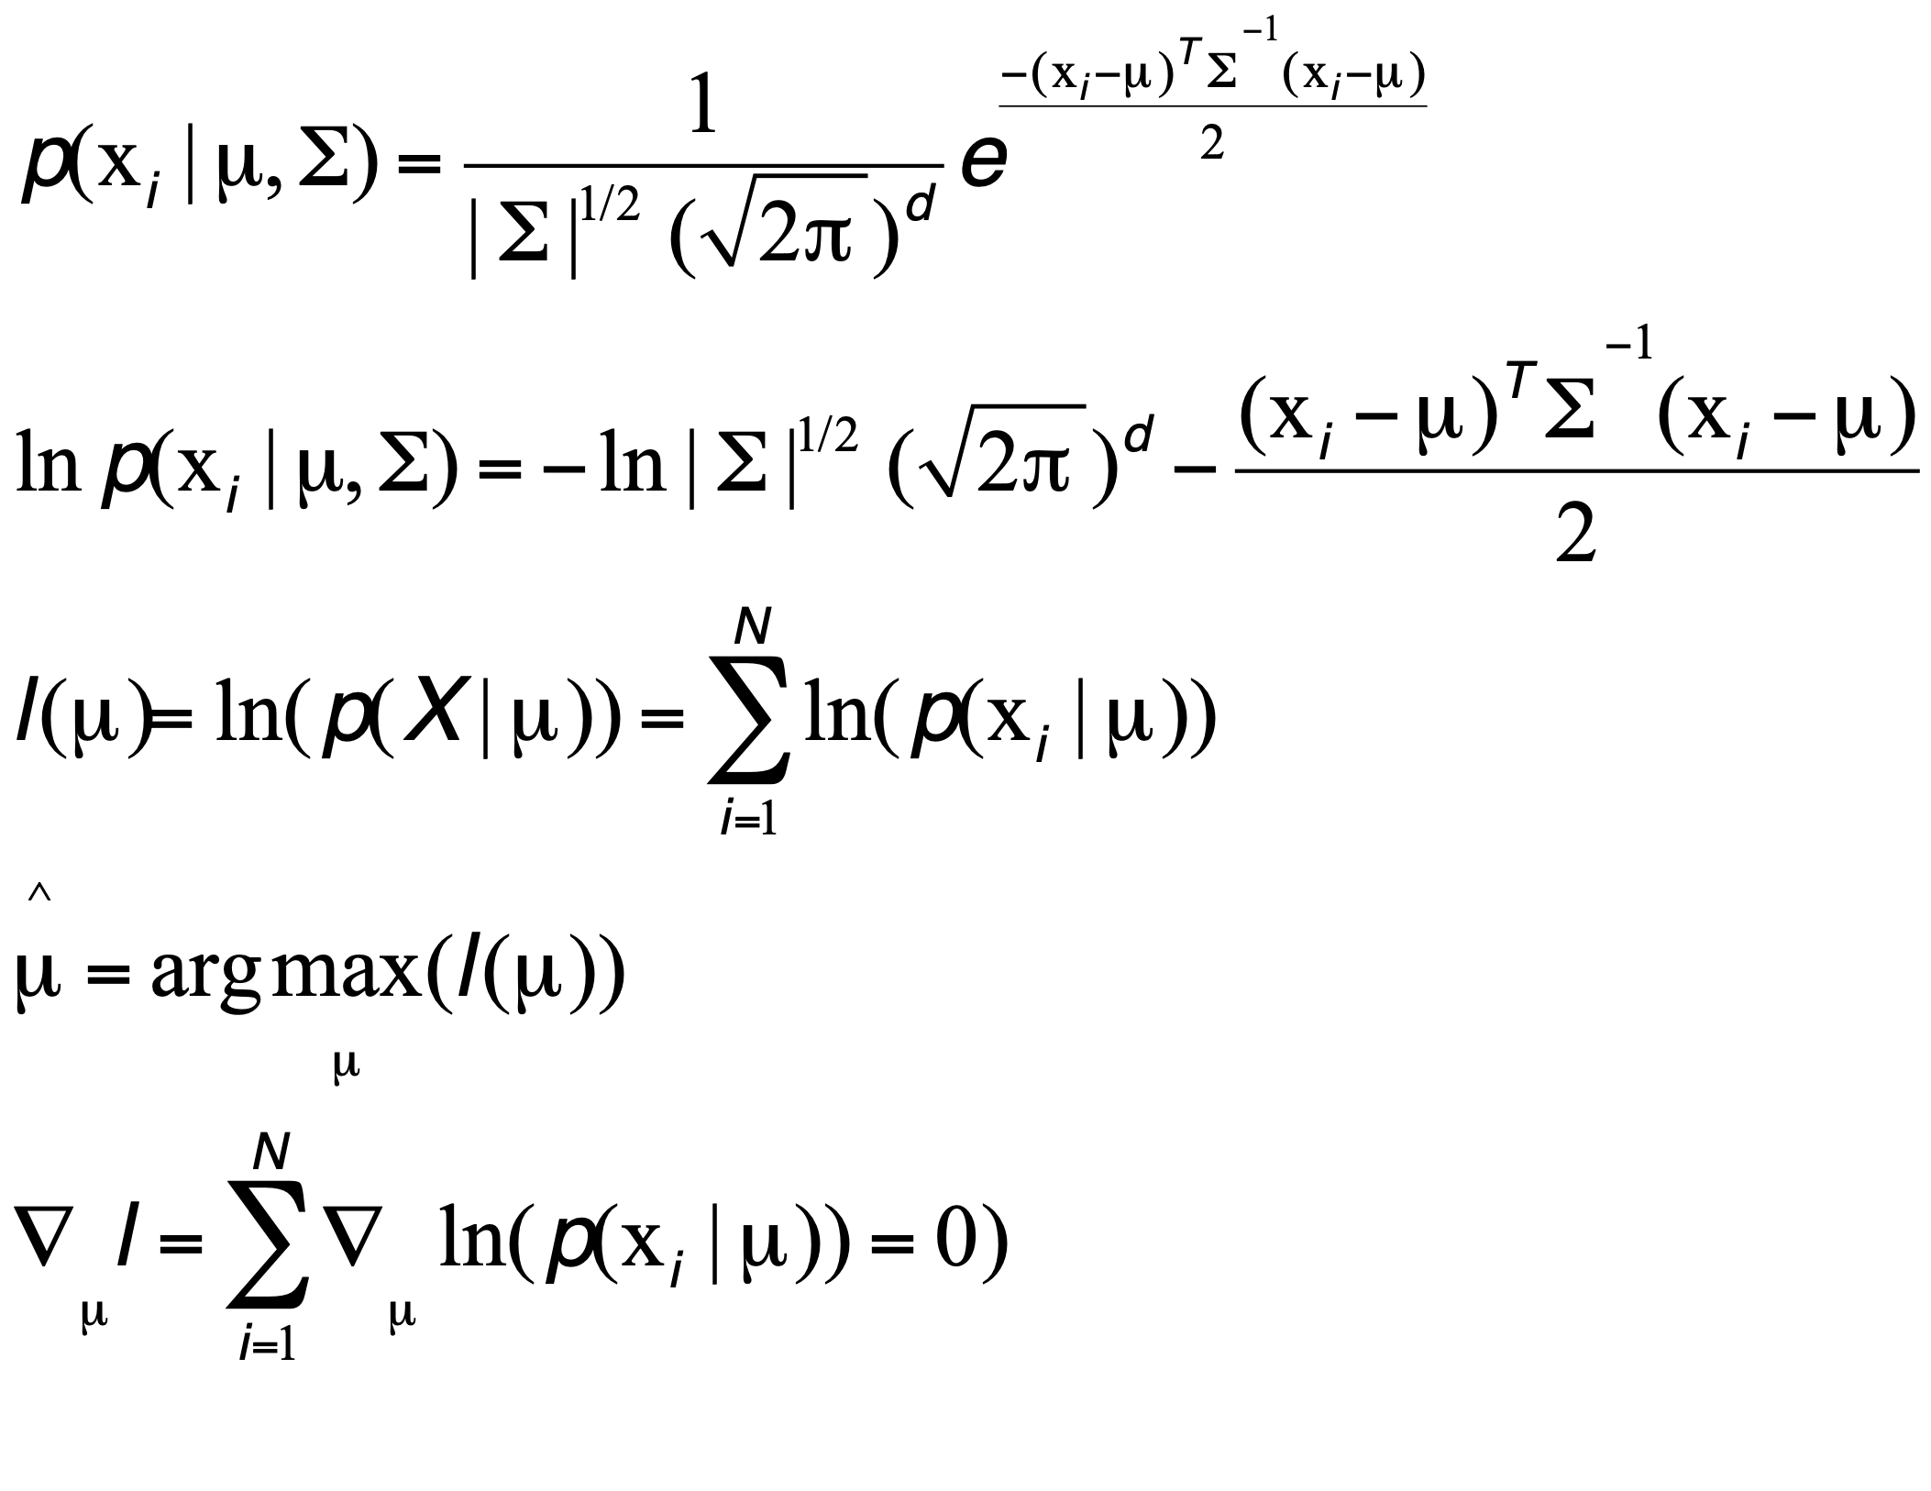
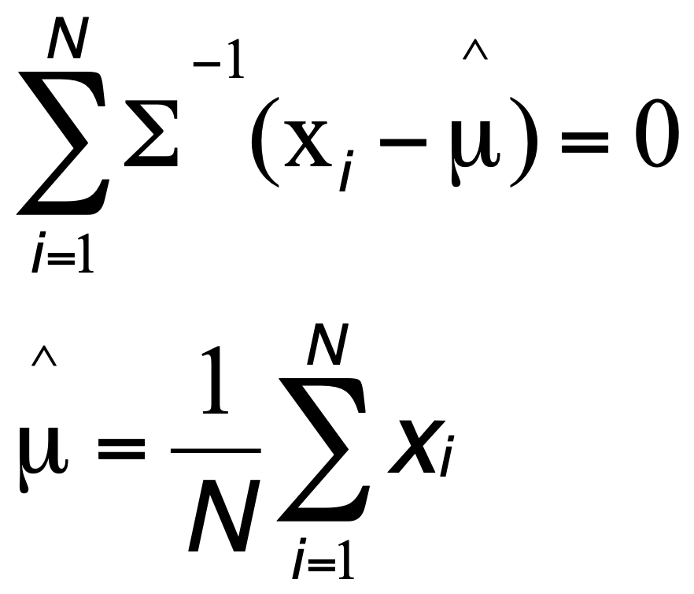
Solving for mean vector

Slide 26
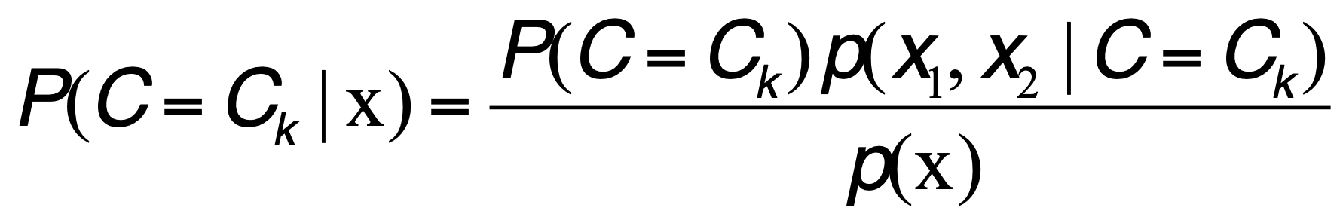
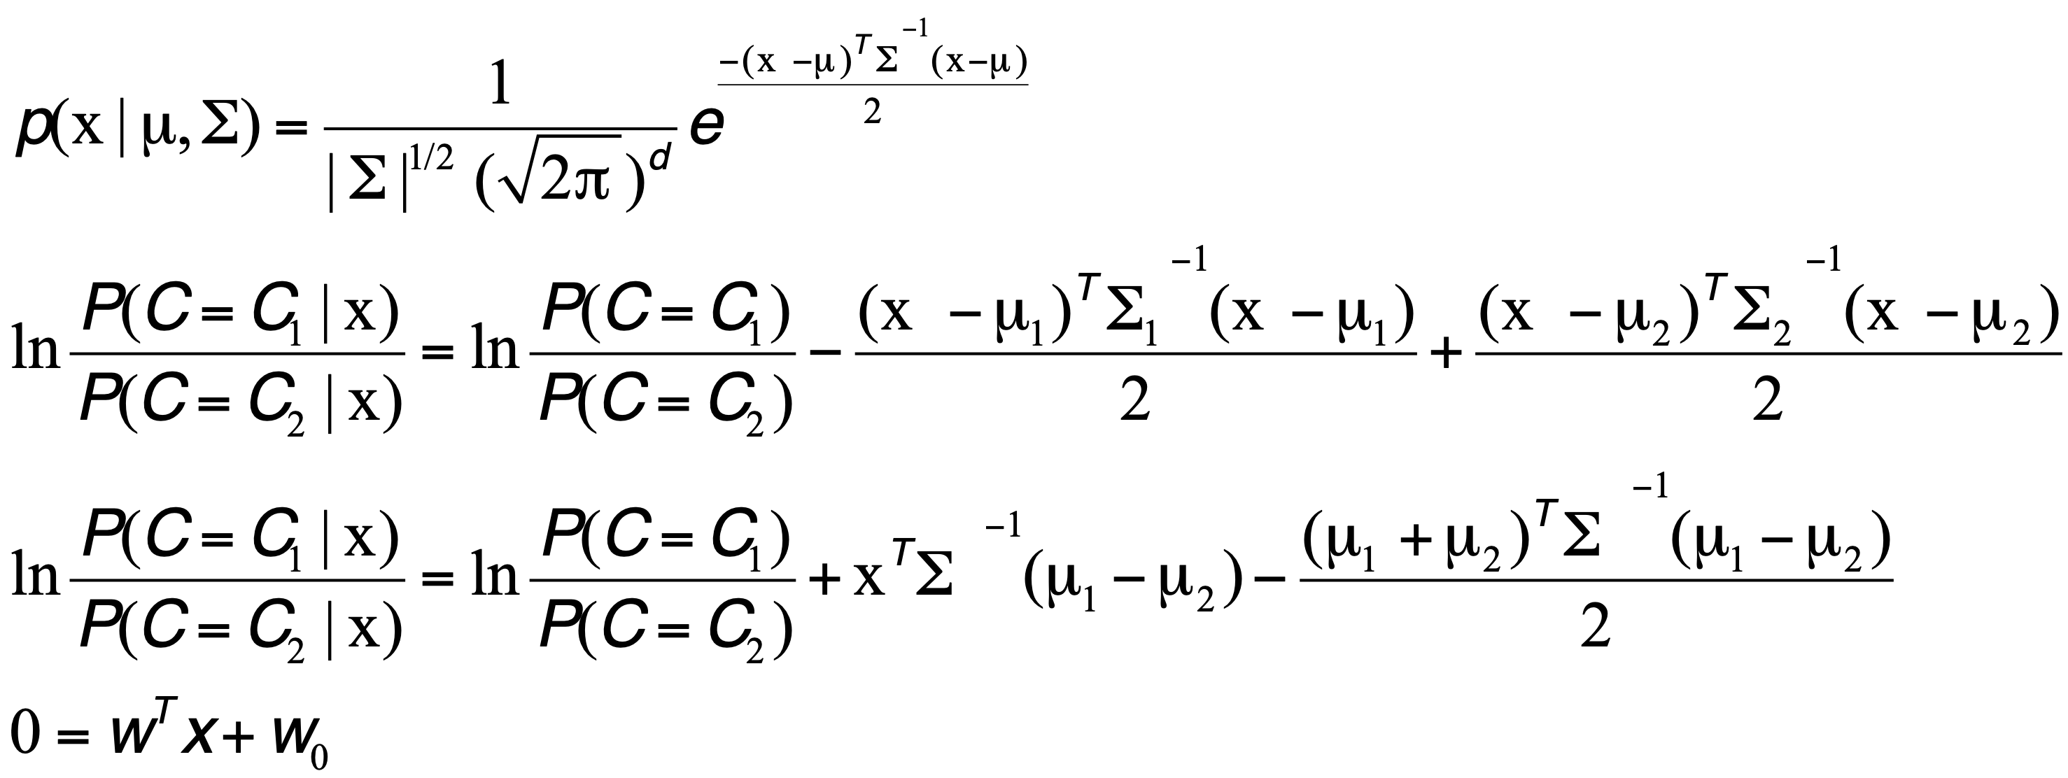
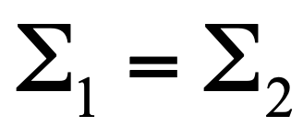
Gaussian Bayes Classifier = Gaussian/Linear Discriminant Analysis

Slide 27
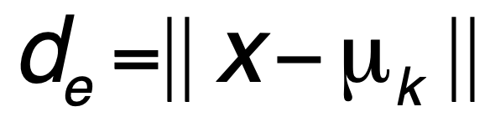
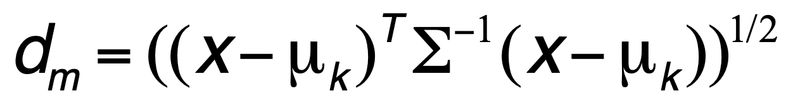
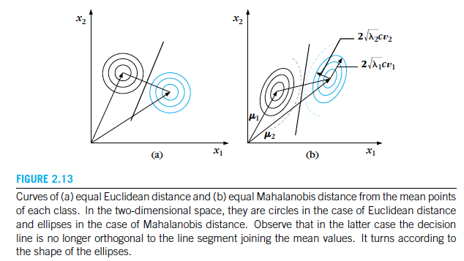
Linear Discriminant (Normal dist. with equal covariance)

